Slide 1
Meiosis

Slide 2
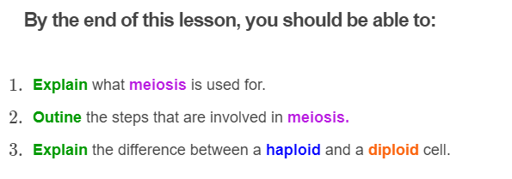
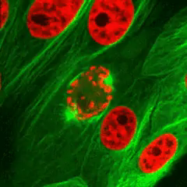

Slide 3
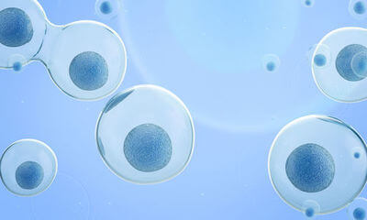
Like mitosis, meiosis is a type of cell division.
This means it makes new cells by splitting old cells in half.

Slide 4
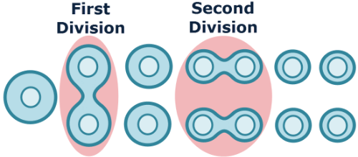
Meiosis is a special type of cell division.
In meiosis, cells divide twice. This means that meiosis has two rounds of cell division.
First, one parent cell divides to produce two daughter cells. These daughter cells then divide again to produce four daughter cells.

Slide 5
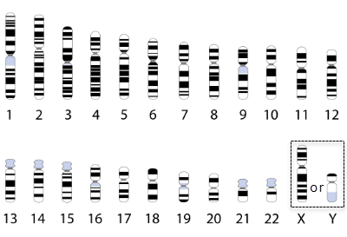
The final four daughter cells are haploid, meaning they have only one copy of each chromosome.
This is different from the cells produced in mitosis, which are diploid.
You may remember from previous lessons that the only haploid cells in your body are your gametes: the sperm and the egg.
Meiosis makes gametes!

Slide 6
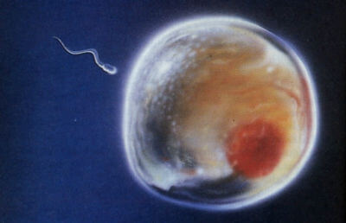
Gametes are used in sexual reproduction.
The sperm will fuse with the egg, fertilising it. This produces a single cell called a zygote. The zygote grows, using mitosis, into a baby.
The zygote inherits all of the chromosomes found in the sperm and the egg. For this reason, gametes need to be haploid to make sure the zygote gets the correct number of chromosomes.

Slide 7
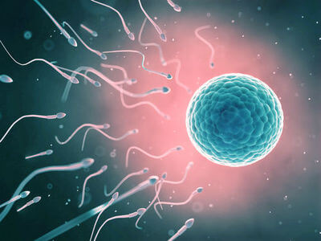
You may have figured out already that meiosis has a very different purpose from mitosis.
Mitosis enables an organism to grow and recover from injury. In comparison, meiosis is used to make gametes for sexual reproduction.
Both types of cell division are important. Without meiosis you would never have been concieved and without mitosis you would never have grown into the individual you are!

Slide 8
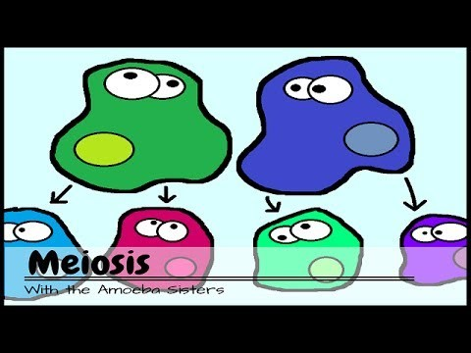

Slide 9
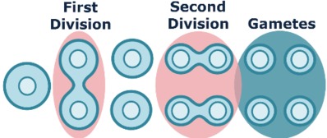
In summary:
1. | Meiosis is used for sexual reproduction.
2. | It has two rounds of cell division.
3. | This makes four haploid daughter cells called gametes. These are the sperm and the egg.

Slide 10
There are a number of steps in meiosis.
Before going into each step in detail, here is a quick overview of what happens.
1. | Before meiosis starts, the parent cell replicates its DNA.
2. | The chromosomes then move to the centre of the cell.
3. | Homologous chromosomes are separated. This is an important step which does not happen in mitosis!
4. | The cell membrane pinches the cell in half. Both daughter cells then enter a second round of division.
5. | Again, chromosomes move to the centre of the cells.
6. | This time sister chromatids are separated.
7. | The cell membrane pinches both cells in half.

Slide 11
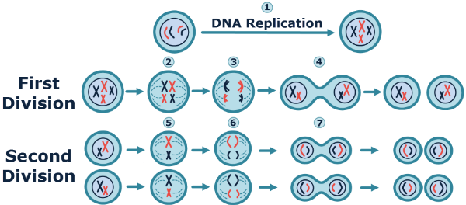

Slide 12
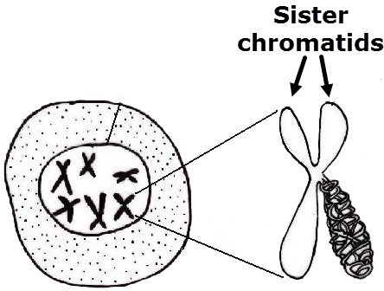
Before meiosis begins, the parent cell replicates its DNA.
Meiosis then starts with the DNA condensing into chromosomes.
Remember, chromosomes are X shaped after DNA replication. The left and right arms of the X are called sister chromatids and are copies of the same chromosome.

Slide 13
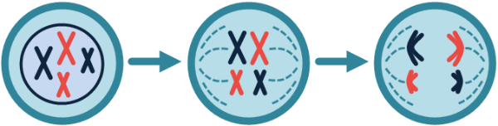
Next, the parent cell's nuclear membrane breaks down and the chromosomes move to the equator (centre) of the cell.
The homologous chromosomes are placed side by side. A network of fibres separate the homologous chromosomes, pulling them to opposite poles (ends) of the cell.
Remember, homologous pairs contain a maternal and a paternal copy of the same chromosome. Therefore, each side of the cell recieves one maternal or one paternal copy of each chromosome.

Slide 14
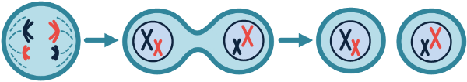
Nuclear membranes reform around the separated chromosomes and the cell membrane pinches off to make two daughter cells.
These daughter cells are haploid and have a mixture of paternal and maternal chromosomes.

Slide 15
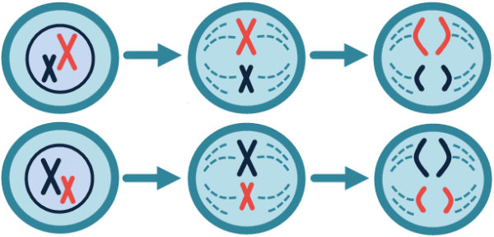
However, meiosis is not over yet.
Both daughter cells start another round of cell division.
The nuclear membranes break down again and the chromosomes align at the equator of the cell. This time, the fibre network separates the sister chromatids.

Slide 16
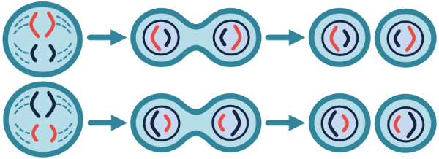
Nuclear membranes form at each end of the cells and the cell membranes pinch the cells in half.
This produces four haploid daughter cells called gametes.
Now meiosis is finished.

Slide 17
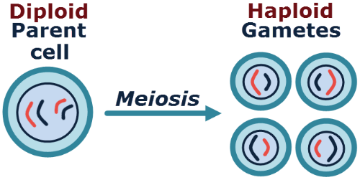
Because the gametes are haploid, their genetic content is different from their diploid parent cell.
The gametes are also different from one another, as they contain different combinations of maternal and paternal chromosomes.

Slide 18
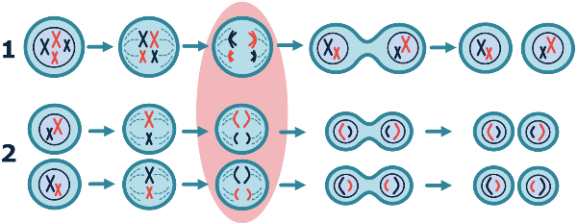
To turn a diploid parent cell into haploid daughter cells, meiosis involves two rounds of cell division.
This means there are a lot of steps, so it can be confusing. Fortunately, most of the steps are the same!
The main difference between the two rounds of division is that in the first round the homologous chromosomes are separated, while in the second round the sister chromatids are separated.

Slide 19
